Slide 1
Investments AI Circle
FOLLOW-UP
8 September 2025

Slide 2

Index
1) Survey
2) Recent updates in AI
3) Vanguard Insights: How AI Could Offset the Baby Boomer Retirement Wave
4) OpenAI Research: Why language models hallucinate
5) Takeaways

Slide 3
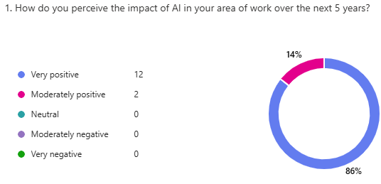
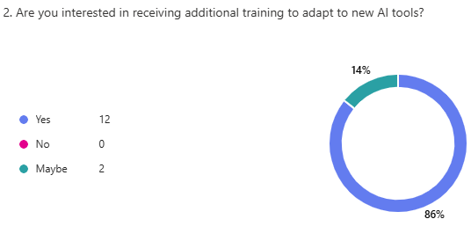
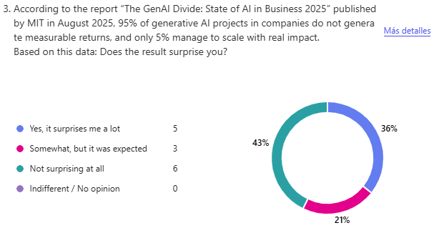
1) Survey (I)

Slide 4
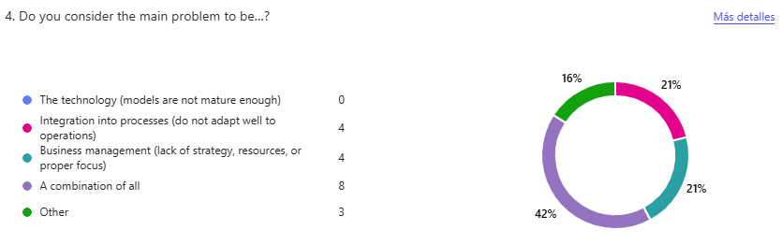
1) Survey (II)
5. If 'Other' is selected, please write your thoughts.
Answers
Tech stack and infrastructure not planned accordingly.
Profit is always measured in financial terms, rather than in terms of time. The latter allows for longer-term improvements.
AI adoption and complex agent design/usage remains early stage, this will come with time not in a big bang.
Maybe people are setting too high expectations in the beginning or starting with overly complex projects, instead of simpler ones.
Essentially, we have a new (and very powerful) tool whose capabilities and applications are far from fully understood. So, many companies are trying to figure that out by trial and error (very fast, if possible) to not fall behind. Obviously, this approach often translates into a lot of "misses" that could be traced, for instance, to wrong/precipitated business decisions, (very) high implementation and operational challenges and/or models' miscomprehension. In my opinion, that this is not particularly wrong. It is just a matter of balancing trade offs during this phase of the IA learning curve.

Slide 5
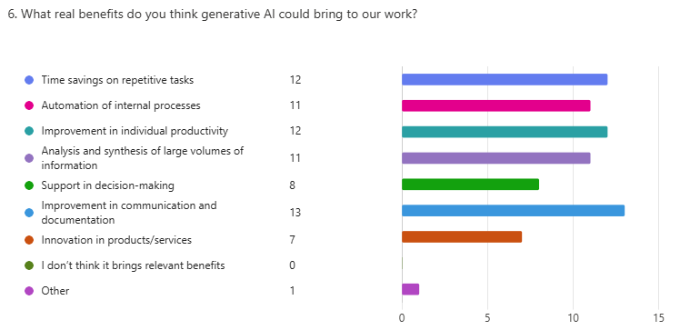
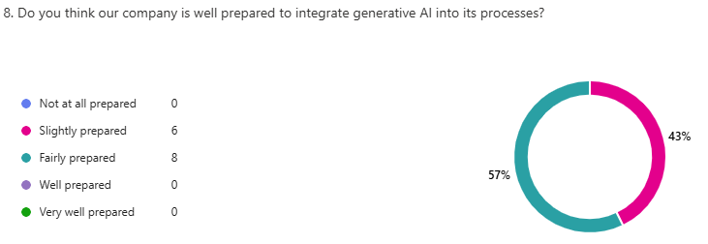
1) Survey (I)
7. If 'Other' is selected, please write your thoughts.
Answers
Augmentation (i.e., not only improve productivity but also expand the universe/scope of markets, activities, and tasks performed).

Slide 6
1) Survey (II)
Can you think of any idea, project, or exploratory path that we could evaluate or develop within SAM based on these advances?
Answers
I think we could map out the initiatives that are being developed around the use of ChatGPT and the creation of AI/GPT agents and then set up multidisciplinary and cross-country groups to accelerate this development.
Many ideas but a API-based AI tooling is needed.
Latam-GPT seems particularly interesting given the potential insights it might offers into key markets for SAM.

Slide 7
2) Recent updates in AI (I)
Recent AI developments highlight progress in sustainability (Gemini, Mistral), open-source innovation (LangExtract, Latam-GPT), new business and revenue models (Perplexity Comet Plus), collaborative safety testing (OpenAI & Anthropic), and the global race to autonomous agents (DeepSeek)—signaling both rapid technological gains and shifting industry dynamics.
Sustainable AI
AI Accountability & Reality Check
1) Mistral Large 2: Measuring AI’s Environmental Footprint
Training emitted ~20,400 tons CO₂ and consumed ~281,000 m³ water; a 400-token exchange emits ~1.14 g CO₂ and ~45 ml water.
Training+inference drive 85% of CO₂ and 91% of water use; study follows Frugal AI methodology to set comparable standards.
3) MIT: 95% of GenAI Projects Fail to Deliver Value
Most fail due to a learning gap with workflows, poor resource allocation, and low-ROI “shiny” use cases; only ~5% reach production.
Success depends on governance, integration, and organizational readiness—not tech alone.
2) Gemini and the Carbon Cost of AI
A median prompt uses ~0.24 Wh, 0.26 ml water, and 0.03 g CO₂—roughly a web-page load or 9 seconds of TV.
From May ’24 to May ’25, energy fell 33× and emissions 44× thanks to cleaner power and more efficient chips/models.
4) OpenAI & Anthropic: Cross-Lab Safety Tests
Evaluated Claude Opus/Sonnet and GPT-4o/4.1/o3/o4-mini on jailbreaks, hallucinations, instruction hierarchy, and scheming.
Claude excelled at hierarchy and prompt-extraction resistance (more refusals); OpenAI resisted jailbreaks better (fewer refusals) but hallucinated more.

Slide 8
2) Recent updates in AI (I)
Recent AI developments highlight progress in sustainability (Gemini, Mistral), open-source innovation (LangExtract, Latam-GPT), new business and revenue models (Perplexity Comet Plus), collaborative safety testing (OpenAI & Anthropic), and the global race to autonomous agents (DeepSeek)—signaling both rapid technological gains and shifting industry dynamics.
AI models
New AI Revenue Models
5) DeepSeek Prepares an AI Agent by Year-End
Agent aims to perform multi-step tasks with minimal input and learn from prior actions.
Positions DeepSeek to challenge OpenAI on autonomous agents with a low-cost innovation strategy.
8) Perplexity Comet Plus: New Revenue for Journalism
Pays publishers for human visits, search citations, and AI-agent actions; distributes subscription revenue minus compute.
Bundled with Pro/Max to create sustainable economics as AI reshapes information consumption.
6) Latam-GPT: Open-Source Model for Latin America
50B-parameter model trained on 8TB of regional data from 33 institutions to capture dialects and cultural nuance.
Free, open model for adaptation in education, healthcare, and agriculture.
7) Google’s LangExtract: Open-Source Structured Extraction
Extracts structured data from long, messy text via chunking, parallelism, and multi-pass prompts with only a few examples.
Maps every field to exact source spans, offers HTML review, and works with Gemini (cloud) and Ollama (local), Apache-2.0.

Slide 9
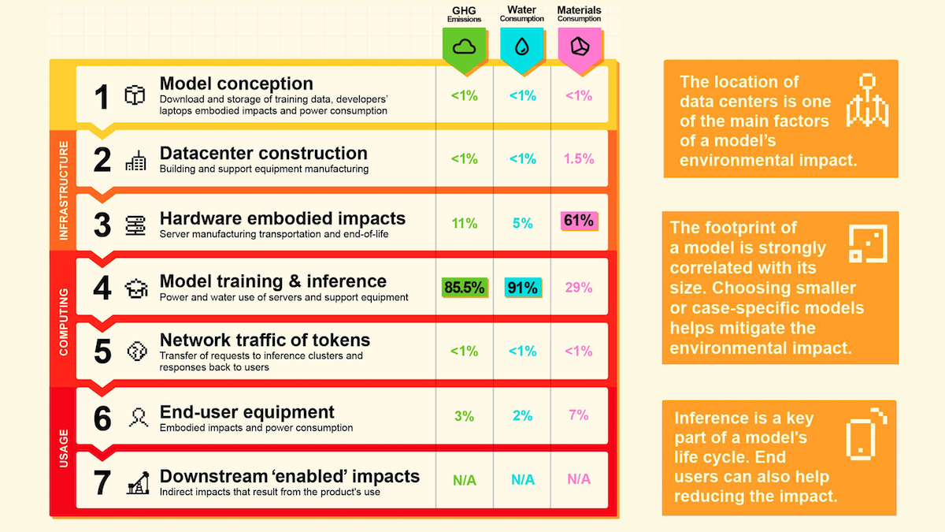
2.1) Mistral Large 2: Measuring AI’s Environmental Footprint
Mistral published a full life-cycle environmental analysis of its flagship 123B parameter model, aiming to set a standard for measuring AI’s impact on greenhouse gases, water, and materials.
Training impact: Producing Mistral Large 2 emitted 20,400 tons of CO₂ (≈4,400 cars annually) and consumed 281,000 cubic meters of water (≈500 years of a U.S. family’s usage).
Resource breakdown: Training + inference drove 85% of CO₂ and 91% of water usage, while server manufacturing and decommissioning accounted for 61% of material depletion.
Per prompt footprint: A 400-token response emitted 1.14g of CO₂ (like watching 10s of YouTube in the U.S.), used 45ml of water, and consumed materials equivalent to minting a 2 Euro coin.
Link:
General framework for frugal AI
Why it matters: Mistral’s audit, based on Frugal AI methodology, represents one of the most rigorous efforts to quantify AI’s environmental toll. If adopted broadly, it could create benchmarks to compare models, encourage greener infrastructure, and push the industry toward sustainable.

Slide 10
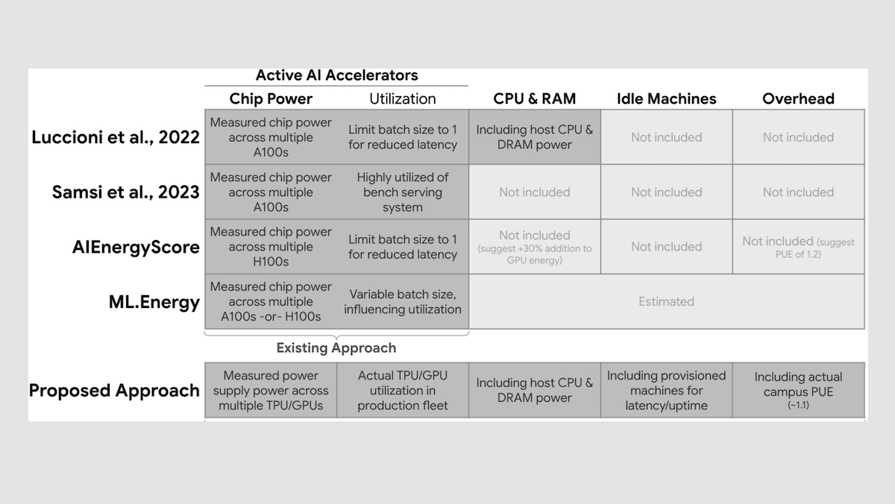
2.2) Gemini and the Carbon Cost of AI: A Greener Outlook from Google
Google published a rare, in-depth analysis of the environmental impact of its Gemini models—revealing lower-than-expected resource usage for everyday AI tasks.
Measured footprint: A median Gemini prompt consumes just 0.24 watt-hours, 0.26 ml of water, and 0.03g of CO₂—comparable to loading a web page or running a TV for 9 seconds.
Efficiency gains: Between May 2024 and May 2025, Gemini's energy usage dropped 33x and emissions fell 44x, driven by cleaner energy sourcing and more efficient chips and models.
Links:
Measuring the environmental impact of delivering AI at Google Scale
Life-Cycle Emissions of AI Hardware: A Cradle-To-Grave Approach and Generational Trends
Google says a typical AI text prompt only uses 5 drops of water — experts say that’s misleading
Why it matters: The lack of standard metrics has made AI’s environmental cost hard to assess. Google’s transparency is a step forward, but comparisons remain tricky due to differing scopes. Industry-wide standards will be key to meaningful climate accountability in AI.

Slide 11
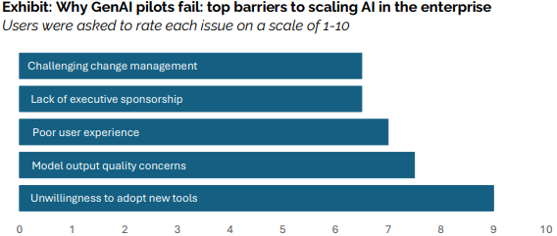
2.3) MIT: 95% of Generative AI Projects Fail to Deliver Value
MIT’s State of AI in Business 2025 report reveals that 95% of enterprise GenAI initiatives fail to produce measurable financial returns, despite heavy corporate investment.
Root causes of failure: According to MIT, most projects collapse due to a learning gap between AI tools and business workflows, poor resource allocation, and a focus on “shiny” but low-ROI use cases like marketing rather than high-impact back-office automation.
Scale of underperformance: Only 5% of pilots progress to production and deliver real business value, with the vast majority stuck in experimental mode or misaligned with P&L metrics.
Link:
MIT: State of AI in Business 2025 Report
Why it matters: MIT’s findings underscore that success with AI is less about technology and more about organizational readiness, workflow integration, and disciplined governance.

Slide 12
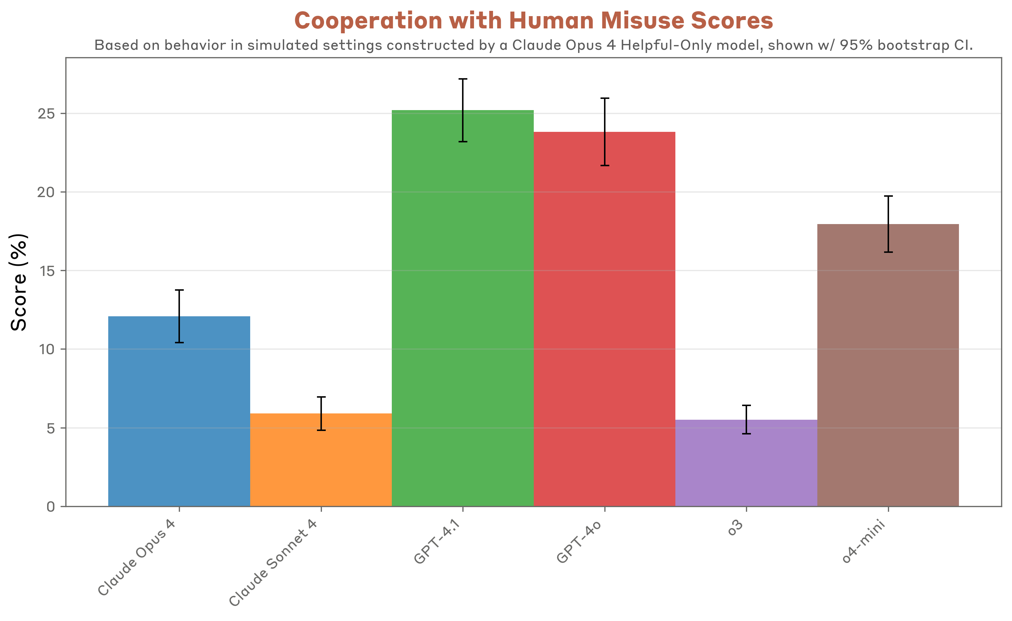
2.4) OpenAI & Anthropic: Cross-Lab Safety Testing for Industry Standards
For the first time, two leading AI labs shared results from testing each other’s models against adversarial safety benchmarks—an effort to increase accountability and transparency in AI development.
Test scope: Claude Opus 4, Claude Sonnet 4, GPT-4o, GPT-4.1, o3, and o4-mini were evaluated on jailbreaking, hallucinations, instruction hierarchy, and scheming behaviors in adversarial conditions.
Findings: Claude models excelled at respecting instruction hierarchy and resisting system prompt extraction, though they refused more factual queries. OpenAI’s reasoning models resisted jailbreaks better and refused less, but showed higher hallucination rates.
xAI does not do this kind of tests with Grok
Why it matters: This collaboration sets a precedent for cross-lab accountability, offering a path toward shared safety standards and greater public trust in AI systems. If adopted widely, such evaluations could become a cornerstone of responsible AI governance.
Link:
Findings from a pilot Anthropic–OpenAI alignment evaluation exercise: OpenAI Safety Tests | OpenAI

Slide 13

2.5) DeepSeek Prepares AI Agent to Rival OpenAI by Year-End
Chinese startup DeepSeek, which shook the industry with its low-cost R1 reasoning model, is now targeting the release of a more advanced AI agent in the final quarter of this year.
Technical progress: The new system is designed to execute multi-step tasks with minimal user input and to learn from prior actions, moving closer to autonomous, self-improving agents.
Strategic positioning: Founder Liang Wenfeng is pushing the team to accelerate development as U.S. and Chinese rivals roll out increasingly powerful models.
Why it matters: If successful, DeepSeek could challenge OpenAI on the emerging frontier of autonomous AI agents. Its low-cost innovation strategy underscores the global race to deliver practical, reasoning-capable systems that can act on behalf of users at scale.
Link:
https://www.cryptopolitan.com/deepseek-takes-on-openai-with-new-features/

Slide 14

2.6) Latam-GPT: Latin America’s Open-Source Alternative to ChatGPT
The Chilean National Center for Artificial Intelligence (CENIA), in partnership with 33 institutions across Latin America and the Caribbean, launched Latam-GPT, a 50B parameter open-source model trained on 8TB of regional data to reflect local languages and cultural contexts.
Technical progress: Comparable to GPT-3.5, Latam-GPT is designed to capture regional dialects, history, and cultural nuances that global models often overlook.
Open access: The first version, released this year, will be freely available for adaptation in key sectors such as education, healthcare, and agriculture—enabling local researchers to experiment directly with large-scale models.
Why it matters: Latam-GPT represents a milestone in democratizing AI, giving Latin America ownership over culturally relevant AI infrastructure. It underscores a global trend toward regional AI sovereignty and sector-specific innovation through open-source approaches.
Link:
Latam-GPT: The Free, Open Source, and Collaborative AI of Latin America | WIRED

Slide 15
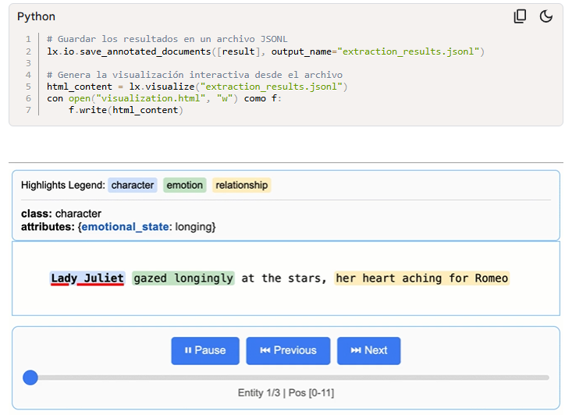
2.7) Google’s LangExtract: Open-Source Library for Structured Data Extraction
Google released LangExtract, an open-source Python tool designed to extract structured information from unstructured text using large language models.
Technical progress: LangExtract handles long, complex documents (from clinical notes to literature) with text chunking, parallel processing, and multi-pass extraction, while requiring only a few examples to customize tasks.
Traceability & usability: Each extraction is mapped to its exact text source, with interactive HTML visualizations for validation. It supports Gemini in the cloud as well as local models via Ollama.
Why it matters: Reliable, transparent data extraction is a bottleneck for many AI workflows. LangExtract demonstrates how open-source tooling can make LLM outputs more auditable and actionable—paving the way for safer adoption across domains like healthcare, finance, and research.
Links:
https://developers.googleblog.com/es/introducing-langextract-a-gemini-powered-information-extraction-library/
https://github.com/google/langextract

Slide 16
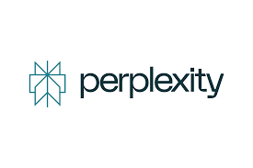
2.8) Perplexity Comet Plus: Redefining the Revenue Model for Journalism
Perplexity introduced Comet Plus, a $5 subscription that challenges the traditional ad-and-click model by compensating publishers whenever AI systems access, cite, or act on their work.
Revenue innovation: Moves beyond pageviews—distributing subscription revenue (minus compute costs) directly to publishers based on human visits, search citations, and AI agent interactions.
Strategic impact: Bundled with Perplexity Pro and Max, Comet Plus positions itself as a sustainable framework for journalism in an AI-first information economy.
Why it matters: By shifting from click-based monetization to AI-driven value sharing, Perplexity signals a fundamental change in how publishers can earn revenue in the age of generative AI.

Slide 17
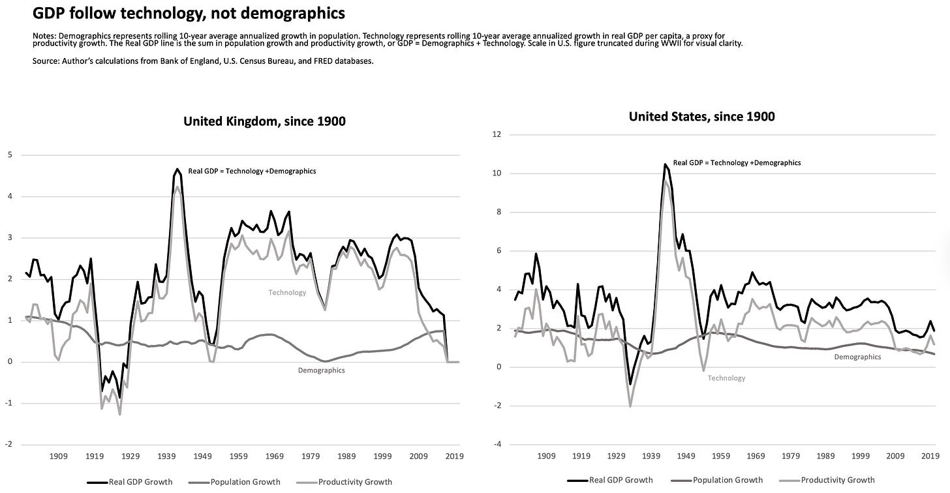
3) Vanguard Insights: How AI Could Offset the Baby Boomer Retirement Wave
The Demographic Challenge
2025 marks the onset of the “silver tsunami”: record numbers of Baby Boomers turning 65 in the US.
Consequences: fewer workers, weaker output, rising fiscal pressures on healthcare and Social Security.
Key insight: demographics shape the economy, but technology historically exerts greater influence.

Slide 18
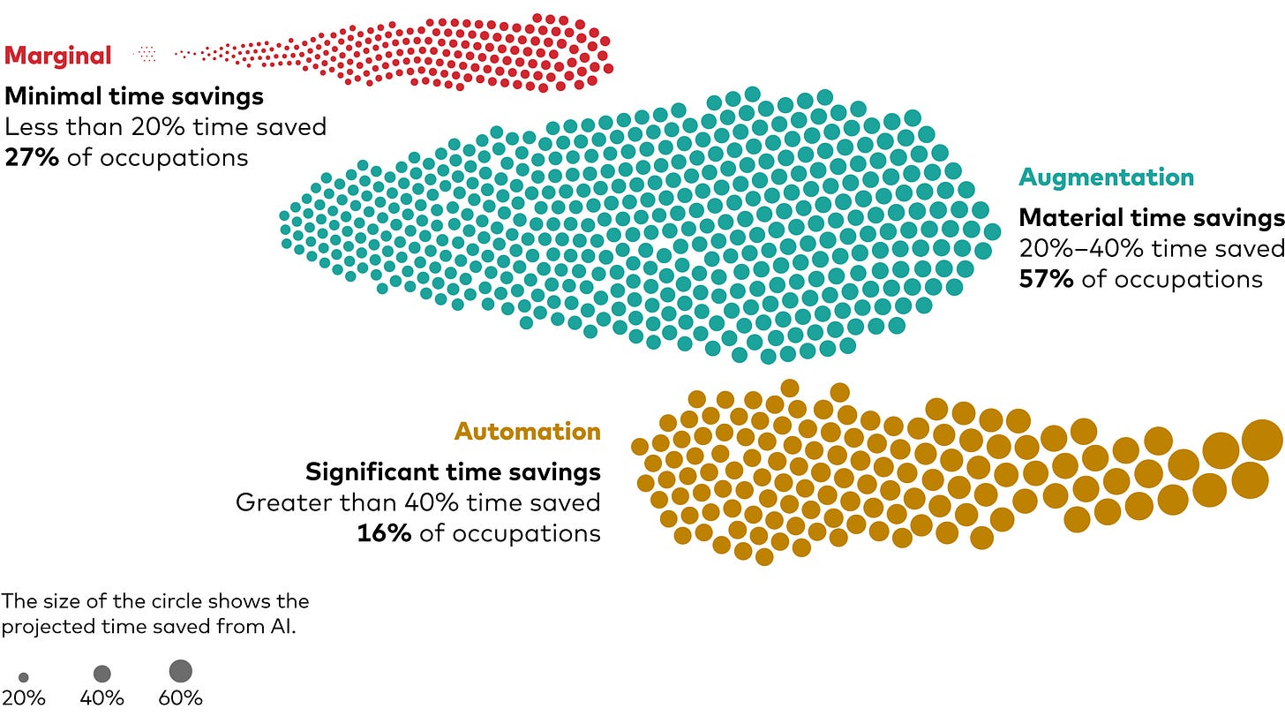
3) Vanguard Insights: How AI Could Offset the Baby Boomer Retirement Wave
AI’s Impact on Work
Occupations map – automation vs. augmentation potential
Vanguard Megatrends Model: most workers will feel AI’s impact, but not as full replacement.
~80% of occupations will experience task augmentation rather than elimination.
Average time savings: ~43% of work tasks.
In the occupations represented by the yellow dots (the 16% of jobs where automation could reach 40%+ time savings), job loss is expected. Source: Joe Davis/Vanguard 2025

Slide 19
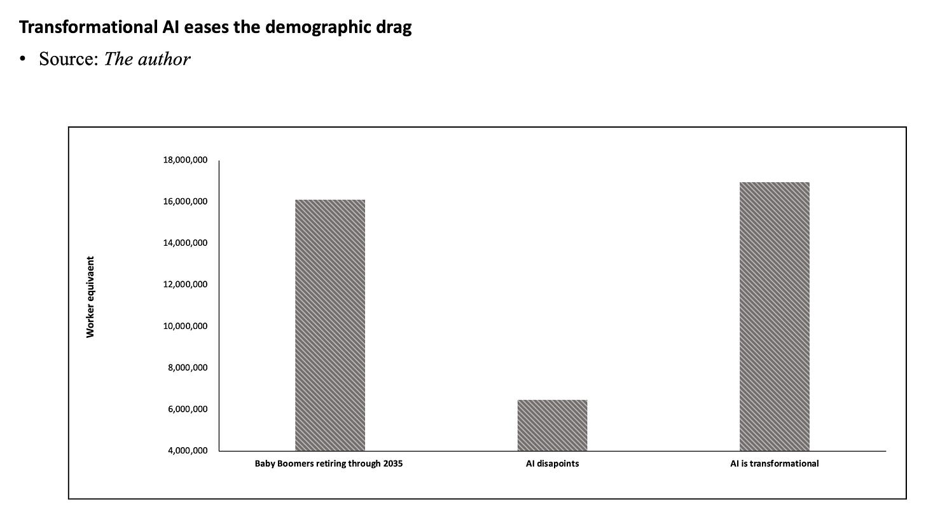
3) Vanguard Insights: How AI Could Offset the Baby Boomer Retirement Wave
Productivity vs. Retirement Shock
AI automates routine tasks, shifting human effort to higher-value activities.
Potential GDP growth boost: near 3% in the 2030s, fastest since the late 1990s.
Scale of productivity gains could offset millions of retirements.
Comparison – Baby Boomer retirements vs. jobs affected vs. transformational AI

Slide 20
3) Vanguard Insights: How AI Could Offset the Baby Boomer Retirement Wave
Scenarios & Investment Takeaways
Two main scenarios ahead:
Productivity Surge (Prob. 45 - 55%)
Deficits Drag (Prob. 30% - 40%)
AI becomes a general-purpose technology (like electricity), sparking new industries, boosting productivity beyond PCs/Internet, moderating inflation, and reducing deficits through stronger growth.
AI disappoints, government deficits climb, borrowing costs rise, inflation is sticky, living standards stagnate, U.S. growth converges with Europe’s.
Key risk driver: Monetary policy has limited ability to offset weak growth if AI underperforms; productivity depends on how effectively organizations leverage AI.
Workforce dynamics: Smooth adoption requires easing occupational transitions, reducing unnecessary certifications, and expanding talent pools to mitigate social disruption.

Slide 21
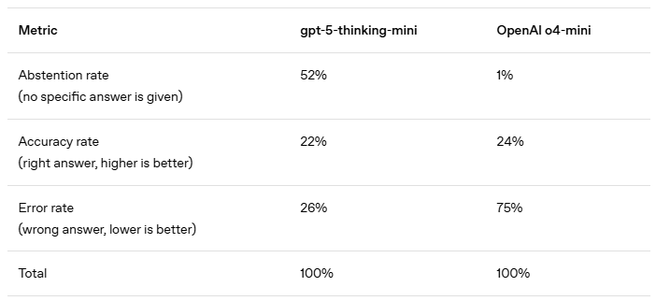
4) OpenAI Research: Why language models hallucinate
Problem: Models often produce confident but false answers.
Cause: Training and evaluation reward guessing over admitting uncertainty.
Insight: Hallucinations are predictable, not random bugs.
Solution: Redesign evaluations to penalize wrong confidence and reward honesty.
Impact: More reliable and trustworthy AI outputs.
Current evaluations reward guessing over abstaining. Models that abstain more (like gpt-5-thinking-mini) avoid many errors, while models pushed to always answer (like o4-mini) score slightly higher in accuracy but “hallucinate” far more. In other words, models are effectively designed to hallucinate in order to achieve better evaluation scores.
Link:
https://openai.com/index/why-language-models-hallucinate/

Slide 22
4) Takeaways (I)
General discussions
Participants expressed overall optimism about AI’s impact, especially in productivity, communication, and document handling.
There was consensus on the need for practical AI training to address uneven adoption and skill levels across different regions.
Many attendees emphasized the importance of starting with simple AI projects to gain experience and confidence before scaling up to complex initiatives.
The MIT report stating that 90–95% of GenAI projects fail sparked agreement. Main reasons discussed:
Unrealistic expectations
Short-term focus over long-term strategy
Lack of technical and governance readiness
Differences in regional AI maturity were noted:
Spain is relatively more advanced.
Brazil’s fintechs are innovating rapidly, unlike larger institutions.
Mexico’s adoption is still in early stages, often constrained by available tools.
Structural limitations of being part of a large bank (e.g., compliance, security) can slow down AI innovation, but also bring resources and stability.

Slide 23
4) Takeaways (II)
General discussions
Interest was shown in sharing AI tools and GPTs developed in different teams to avoid duplication and accelerate collective progress.
Sustainability in AI (energy, emissions, water use) is becoming a key topic, with contrasting approaches by Mistral (audited) and Google (self-reported).
OpenAI’s admission about hallucinations being incentivized by benchmark systems led to reflections on the need to redesign evaluation frameworks.
The Latin GPT initiative from Chile was seen as promising for use in regional applications due to cultural and language alignment.

Slide 24
Gracias
Thank you

